Slide 1
Topic 1:
Introduction to Computer Systems

Slide 2
Objectives
In this chapter, you will learn about:
Software development
Algorithms
Software, hardware, and computer storage
Programming Languages
Common programming errors
Structures of programming
C++ for Engineers and Scientists, Fourth Edition

Slide 3
Software Development
Computer program: Self-contained set of instructions used to operate a computer to produce a specific result
  Also called software
  Solution developed to solve a particular problem, written in a form that can be executed on a computer
C++ for Engineers and Scientists, Fourth Edition

Slide 4
Software Development (continued)
Software development procedure: Helps developers understand the problem to be solved and create an effective, appropriate software solution
Software engineering:
  Concerned with creating readable, efficient, reliable, and maintainable programs and systems
  Uses software development procedure to achieve this goal
C++ for Engineers and Scientists, Fourth Edition

Slide 5
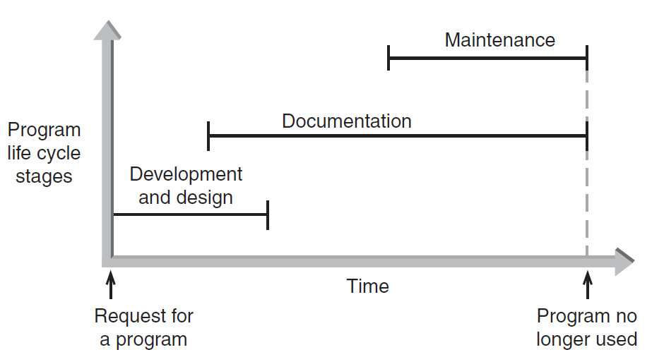
Software Development (continued)
Figure 1.2 The three phases of program development
C++ for Engineers and Scientists, Fourth Edition

Slide 6
Phase I: Development and Design
Program requirement: Request for a program or a statement of a problem
After a program requirement is received, Phase I begins:
Phase I consists of four steps:
  Analysis
  Design
  Coding
  Testing
C++ for Engineers and Scientists, Fourth Edition

Slide 7
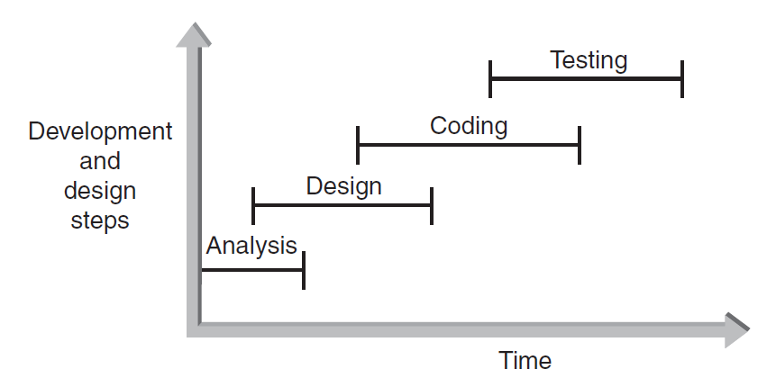
Phase I: Development and Design (continued)
Figure 1.3 The development and design steps
C++ for Engineers and Scientists, Fourth Edition

Slide 8
Phase I: Development and Design (continued)
Step 1: Analyze the Problem
  Determine and understand the output items the program must produce
  Determine the input items
  Both items referred to as the problem's input/output (I/O)‏
C++ for Engineers and Scientists, Fourth Edition

Slide 9
Phase I: Development and Design (continued)
Step 2: Develop a Solution
  Select the exact set of steps, called an “algorithm,” to solve the problem
  Refine the algorithm
    Start with initial solution in the analysis step until you have an acceptable and complete solution
  Check solution
C++ for Engineers and Scientists, Fourth Edition

Slide 10
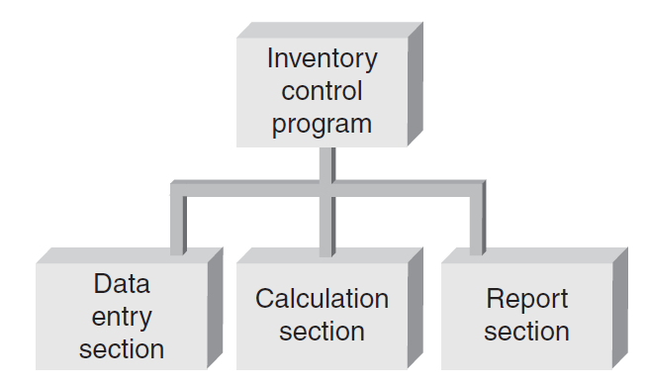
Phase I: Development and Design (continued)
Step 2: Develop a Solution (continued)
  Example: a first-level structure diagram for an inventory tracking system
Figure 1.4 A first-level structure diagram
C++ for Engineers and Scientists, Fourth Edition

Slide 11
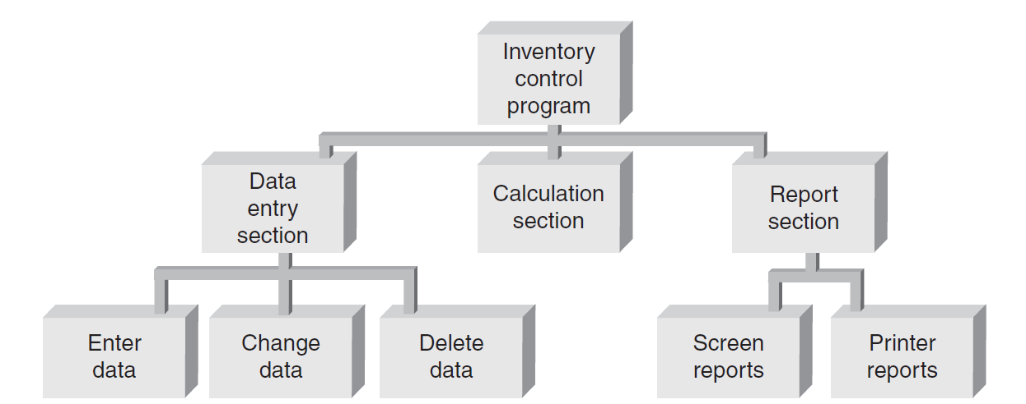
Phase I: Development and Design (continued)
Step 2: Develop a Solution (continued)
  Example: a second-level structure diagram for an inventory tracking system with further refinements
Figure 1.5 A second-level structure diagram
C++ for Engineers and Scientists, Fourth Edition

Slide 12
Phase I: Development and Design (continued)
Step 3: Code the Solution
  Consists of actually writing a C++ program that corresponds to the solution developed in Step 2
  Program should contain well-defined patterns or structures of the following types:
    Sequence
    Selection
    Iteration
    Invocation
C++ for Engineers and Scientists, Fourth Edition

Slide 13
Phase I: Development and Design (continued)
Step 3: Code the Solution (continued)
  Sequence: Defines the order in which instructions are executed
  Selection: Allows a choice between different operations, based on some condition
  Iteration: Allows the same operation to be repeated based on some condition
    Also called looping or repetition
  Invocation: Involves invoking a set of statements when needed
C++ for Engineers and Scientists, Fourth Edition

Slide 14
Phase I: Development and Design (continued)
Step 4: Test and Correct the Program
  Testing: Method to verify correctness and that requirements are met
  Bug: A program error
  Debugging: The process of locating an error, and correcting and verifying the correction
  Testing may reveal errors, but does not guarantee the absence of errors
C++ for Engineers and Scientists, Fourth Edition

Slide 15
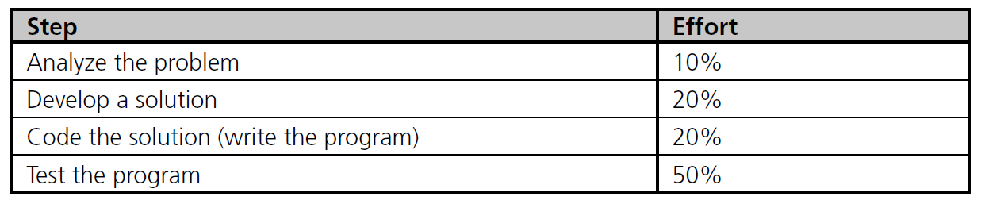
Phase I: Development and Design (continued)
Step 4: Test and Correct the Program (continued)
  Table 1.3 lists the comparative amount of effort typically expended on each development and design step in large commercial programming projects
Table 1.3 Effort Expended in Phase I
C++ for Engineers and Scientists, Fourth Edition

Slide 16
Phase II: Documentation
Five main documents for every problem solution:
  Program description
  Algorithm development and changes
  Well-commented program listing
  Sample test runs
  Users' manual
C++ for Engineers and Scientists, Fourth Edition

Slide 17
Phase III: Maintenance
Maintenance includes:
  Ongoing correction of newly discovered bugs
  Revisions to meet changing user needs
  Addition of new features
Usually the longest phase
May be the primary source of revenue
Good documentation vital for effective maintenance
C++ for Engineers and Scientists, Fourth Edition

Slide 18
Backup
Process of making copies of program code and documentation on a regular basis
Backup copies = insurance against loss or damage
  Consider using off-site storage for additional protection
C++ for Engineers and Scientists, Fourth Edition

Slide 19
Algorithms
Algorithm: Step-by-step sequence of instructions
  Describes how the data is to be processed to produce the desired output
  Must terminate
  Algorithms can be represented in the following ways
C++ for Engineers and Scientists, Fourth Edition

Slide 20
Algorithms (continued)
Pseudocode: English-like phrases used to describe steps in an algorithm
Formula: Mathematical equations
Flowchart: Diagrams with symbols
C++ for Engineers and Scientists, Fourth Edition

Slide 21
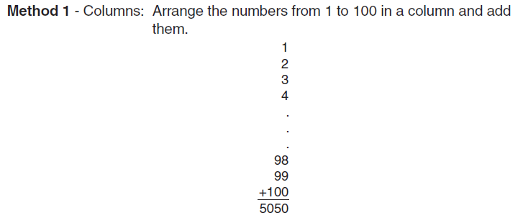
Algorithms (continued)‏
Problem: Calculate the sum of all whole numbers from 1 through 100
Figure 1.6 Summing the numbers 1 to 100
C++ for Engineers and Scientists, Fourth Edition

Slide 22
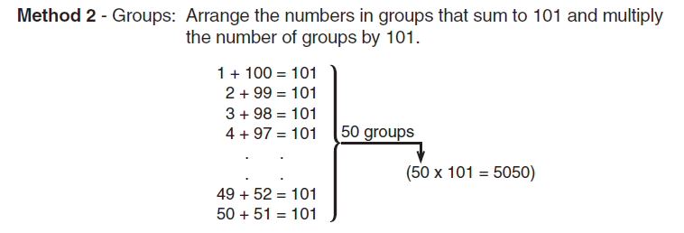
Algorithms (continued)‏
Figure 1.6 Summing the numbers 1 to 100 (continued)
C++ for Engineers and Scientists, Fourth Edition

Slide 23
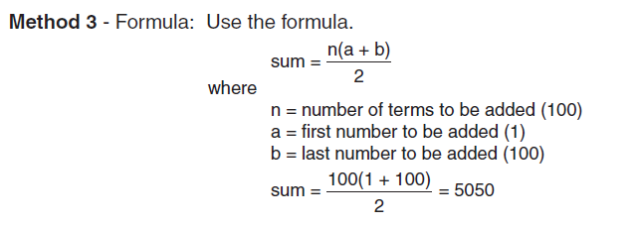
Algorithms (continued)‏
Figure 1.6 Summing the numbers 1 to 100 (continued)
C++ for Engineers and Scientists, Fourth Edition

Slide 24
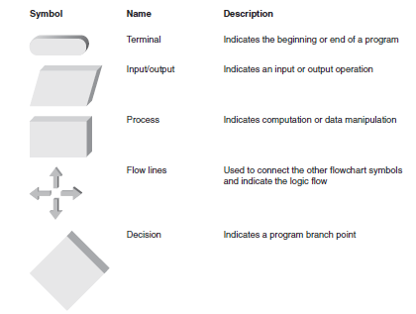
Figure 1.7 Flowchart symbols
C++ for Engineers and Scientists, Fourth Edition

Slide 25
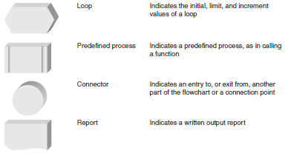
Figure 1.7 Flowchart symbols (continued)
C++ for Engineers and Scientists, Fourth Edition

Slide 26
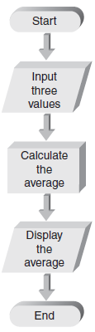
Figure 1.8 Flowchart for calculating the average of three numbers
C++ for Engineers and Scientists, Fourth Edition

Slide 27
Software, Hardware, and Computer Storage
Programming: Process of writing a program, or software
Programming language:
  Set of instructions used to construct a program
  Comes in a variety of forms and types
C++ for Engineers and Scientists, Fourth Edition

Slide 28
Machine Language
Machine language programs: only programs that can actually be used to operate a computer
  Also referred to as executable programs (executables)
  Consists of a sequence of instructions composed of binary numbers
  Contains two parts: an instruction and an address
C++ for Engineers and Scientists, Fourth Edition

Slide 29
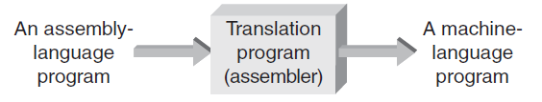
Assembly Language
Assembly language programs: Substitute word-like symbols, such as ADD, SUB, and MUL, for binary opcodes
  Use decimal numbers and labels for memory addresses
    Example: ADD 1, 2
Assemblers: Translate programs into machine language
Figure 1.10 Assembly-language programs must be translated
C++ for Engineers and Scientists, Fourth Edition

Slide 30
Low- and High-Level Languages
Low-level languages: Languages that use instructions tied directly to one type of computer
  Examples: machine language, assembly language
High-level languages: Instructions resemble written languages, such as English
  Can be run on a variety of computer types
  Examples: Visual Basic, C, C++, Java
C++ for Engineers and Scientists, Fourth Edition

Slide 31
Low- and High-Level Languages (continued)‏
Source code: The programs written in a high- or low-level language
  Source code must be translated to machine instructions in one of two ways:
    Interpreter: Each statement is translated individually and executed immediately after translation
    Compiler: All statements are translated and stored as an executable program, or object program; execution occurs later
      C++ is predominantly a compiled language
C++ for Engineers and Scientists, Fourth Edition

Slide 32
Low- and High-Level Languages (continued)‏
Large C++ programs may be stored in two or more separate program files due to:
  Use of previously written code
  Use of code provided by the compiler
  Modular design of the program (for reusability of components)‏
Linker: Combines all of the compiled code required for the program
C++ for Engineers and Scientists, Fourth Edition

Slide 33
Procedural and Object Orientations
Programs can also be classified by their orientation:
  Procedural: Available instructions are used to create self-contained units called procedures
  Object-oriented: Reusable objects, containing code and data, are manipulated
    Object-oriented languages support reusing existing code more easily
C++ contains features of both
C++ for Engineers and Scientists, Fourth Edition

Slide 34
Application and System Software
Application software: Programs written to perform particular tasks for users
System software: Collection of programs to operate the computer system
  System software must be loaded first; called booting the system
  Bootstrap loader: A permanent, automatically executed component to start the boot process
C++ for Engineers and Scientists, Fourth Edition

Slide 35
Application and System Software (continued)‏
Operating system: The set of system programs used to operate and control a computer
  Also called OS
Tasks performed by the OS include:
  Memory management
  Allocation of CPU time
  Control of input and output
  Management of secondary storage devices
C++ for Engineers and Scientists, Fourth Edition

Slide 36
Application and System Software (continued)‏
Multi-user system: A system that allows more than one user to run programs on the computer simultaneously
Multitasking system: A system that allows each user to run multiple programs simultaneously
  Also called multiprogrammed system
C++ for Engineers and Scientists, Fourth Edition

Slide 37
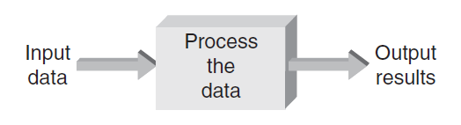
The Development of C++
The purpose of most application programs is to process data to produce specific results
Figure 1.12 Basic procedural operations
C++ for Engineers and Scientists, Fourth Edition

Slide 38
The Development of C++ (continued)‏
Early procedural languages included:
  FORTRAN: Formula Translation
  ALGOL: Algorithmic Language
  COBOL: Common Business Oriented Language
  BASIC: Beginners All-purpose Symbolic Instruction Code
  Pascal
  C
Early object-oriented language:
  C++
C++ for Engineers and Scientists, Fourth Edition

Slide 39
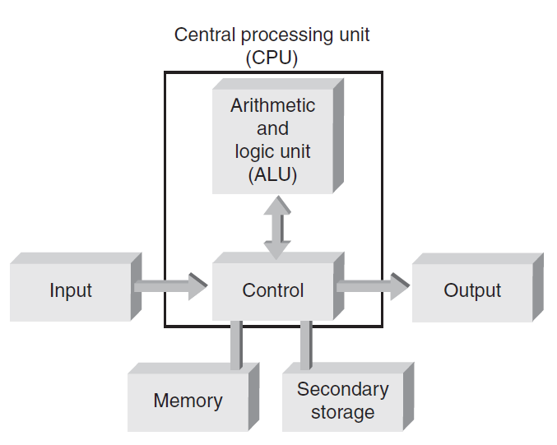
Computer Hardware
Computer hardware: Components that support the capabilities of the computer
Figure 1.15 Basic hardware units of a computer
C++ for Engineers and Scientists, Fourth Edition

Slide 40
Computer Hardware (continued)‏
Components include:
  Arithmetic and logic unit (ALU): Performs arithmetic and logic functions
  Control unit: Directs and monitors overall operations
  Memory unit: Stores instructions and data
  Input and output (I/O) unit: Interfaces to peripheral devices
  Secondary storage: Nonvolatile permanent storage such as hard disks
  Central processing unit (CPU): Also called microprocessor; combines the ALU and control unit on a single chip
C++ for Engineers and Scientists, Fourth Edition

Slide 41
Computer Storage
Bit: Smallest unit of data; value of 0 or 1
Byte: Grouping of 8 bits representing a single character
Character codes: Collection of patterns of 0s and 1s representing characters
  Examples: ASCII, EBCDIC
C++ for Engineers and Scientists, Fourth Edition

Slide 42
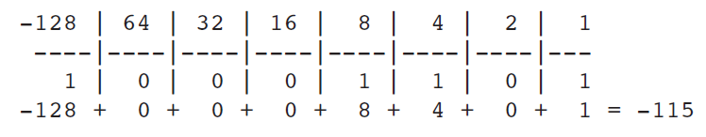
Computer Storage (continued)‏
Number codes: Patterns used to store numbers
Two’s complement number code: Represents a decimal number as a binary number of 0s and 1s
  Determine with a value box
Figure 1.18 Converting 10001101 to a base 10 number
C++ for Engineers and Scientists, Fourth Edition

Slide 43
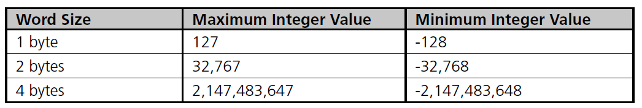
Computer Storage (continued)‏
Word: Grouping of one or more bytes
  Facilitates faster and more extensive data access
Number of bytes in a word determines the maximum and minimum values that can be stored:
Table 1.4 Word size and Integer Values
C++ for Engineers and Scientists, Fourth Edition

Slide 44
Common Programming Errors
Common errors include:
  Failing to use consistent units
  Using an incorrect form of a conversion factor
  Rushing to write and run a program before fully understanding the requirements
  Not backing up a program
  Not appreciating that computers respond only to explicitly defined algorithms
C++ for Engineers and Scientists, Fourth Edition

Slide 45
Summary
To determine correct forms of a conversion factor, perform a unit analysis
Software: Programs used to operate a computer
Programming language types:
  Low-level languages
    Machine language (executable) programs
    Assembly languages
  High-level languages
    Compiler and interpreter languages
C++ for Engineers and Scientists, Fourth Edition

Slide 46
Summary (continued)‏
Software engineering: discipline concerned with creating readable, efficient, reliable, and maintainable programs
Three phases in software development:
  Program development and design
  Documentation
  Maintenance
C++ for Engineers and Scientists, Fourth Edition

Slide 47
Summary (continued)‏
Four steps in program development and design:
  Analyze the problem
  Develop a solution
  Code the solution
  Test and correct the solution
Algorithm: Step-by-step procedure that describes how a task is performed
Computer program: Self-contained unit of instructions and data used to operate a computer to produce a desired result
C++ for Engineers and Scientists, Fourth Edition

